Slide 1

Setup
1 home screen (search input) + four pages (search results)
Import google Material Design CSS, js, icons, and fonts (Roboto)
Tutorials here
Color & layout (tutorial)
Set four theme colors (below)
We will use its grid system to create layouts for all pages
Search results pages will use its backdrop component

Slide 2
Meeting Notes
7/23
Set up Flask pipeline, use placeholder database whose data structure is consistent with Bojian’s ML components
cardiovascular, pediatric mental health, cancer

Slide 3



Home Page
Population of interest
Intervention and outcomes of interest
Search

Slide 4
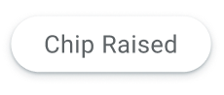
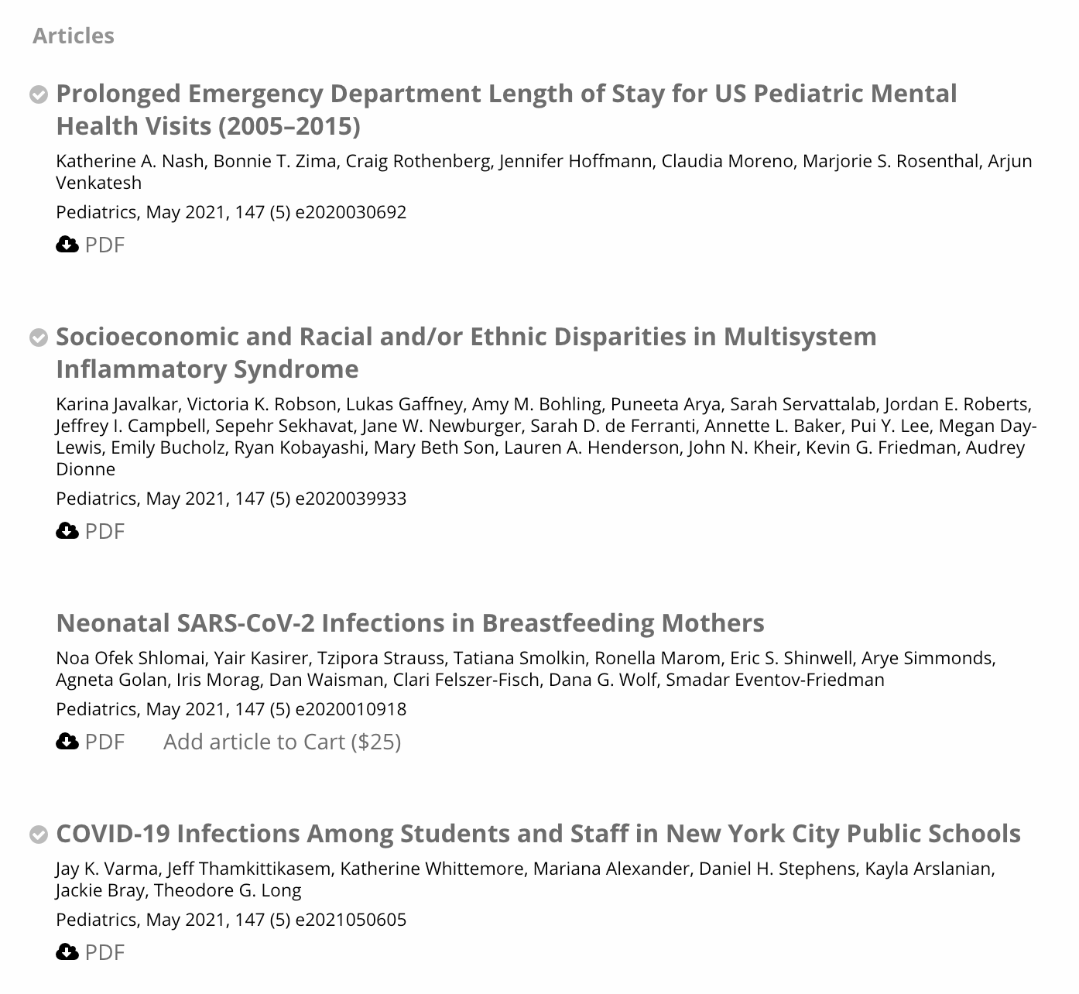

Search Result Page 1
Population -- user’s search term
User’s search term
Review Articles
Controlled Trials
Cohort Study and case Study

Slide 5
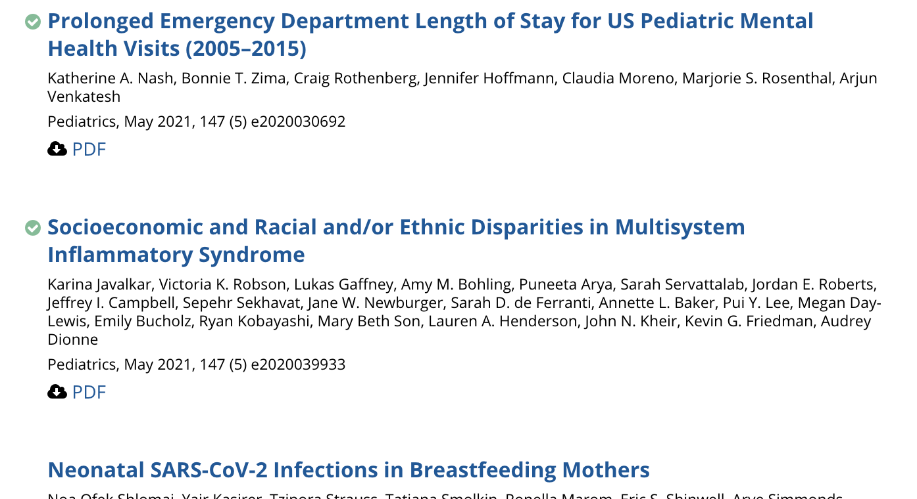
Search Result Page 1
Search for individual & collaborative decision making
Population of interest
Intervention and outcomes of interest
Review Articles
Controlled Trials
Cohort Study, Case Study

Slide 6
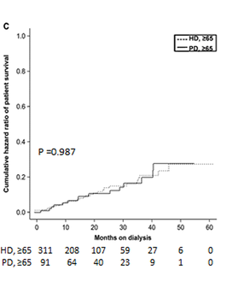
Search Result Page 2 Literature explaining/elaborating on risk model predictions
Population of interest
Intervention and outcomes of interest
Major Risk Factors
Bleeding (an outcome)

Slide 7
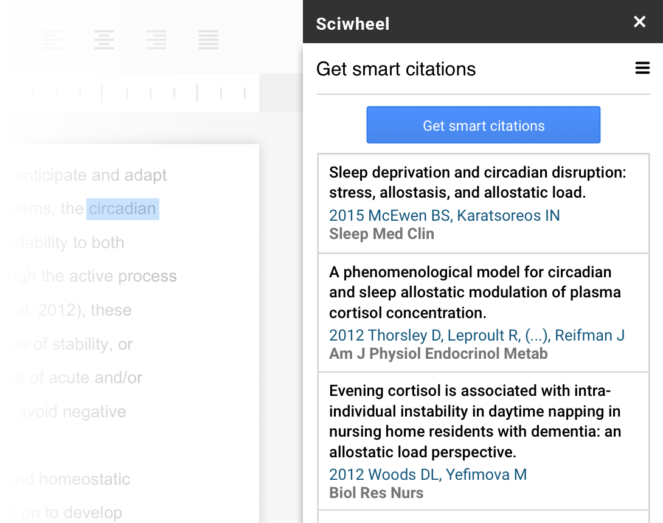
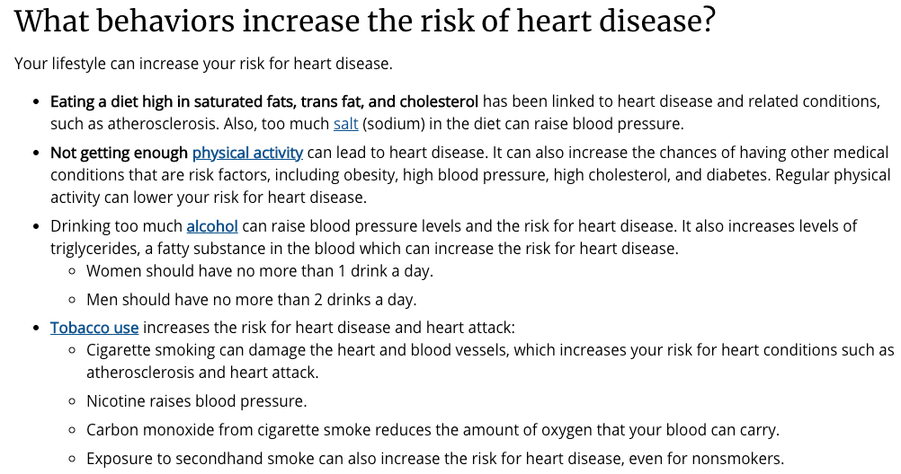
Search Result Page 3
Patient education
Population of interest
Intervention and outcomes of interest
Patient Education Packet

Slide 8
General, reproducible search -- based on population match
Can send complete search with colleagues

Slide 9
Patient facing search

Slide 10
Predictive modeling -- contrastive evidence

Slide 11
Computer vision, image search

